Slide 1
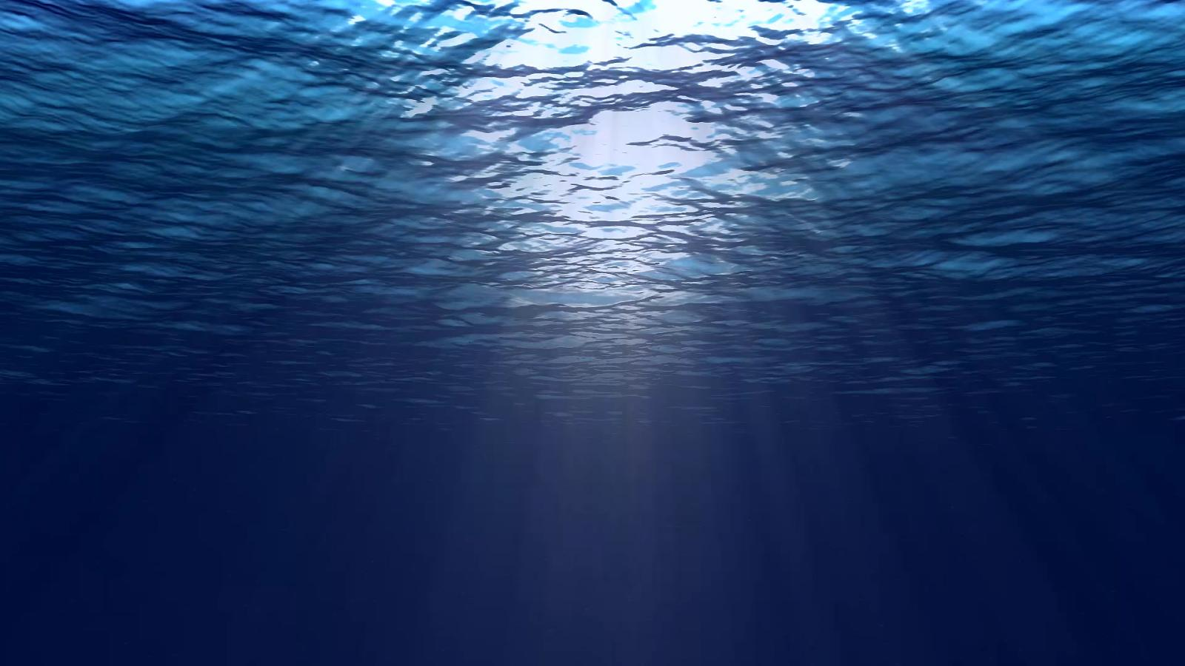
Juan-derful Juan
Juan Ponce de León & La Florida

Slide 2
Notes:
Poem

Slide 3
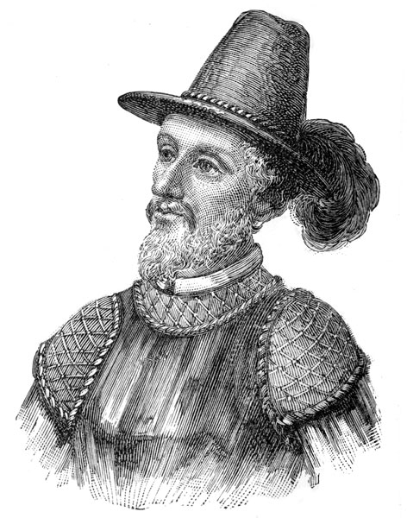
What’s in a Name?
Juan Ponce de León
John
Last Name:
Ponce
Of/From Leon

Slide 4
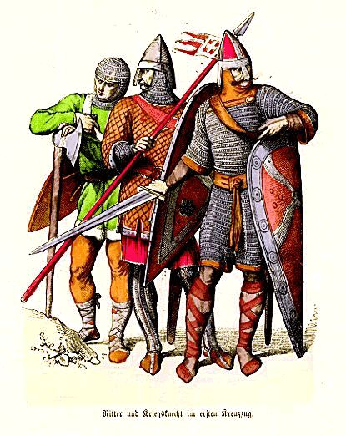
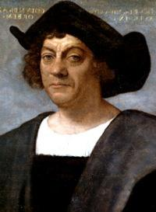
Early Life
1474: Born
Poor Servant
1484: Squire
1493: Spanish Soldier
1493: Met Christopher Columbus
Port of Cadiz
1493: First Trip to the New World
Notes:
Discussion Questions:
What do you think it felt like to meet a famous explorer?
What do you think would have happened if Juan had not decided to go to the port of Cadiz that day?
http://fashionhistory.zeesonlinespace.net/medieval.html
http://www.josephsmithacademy.org/wiki/christopher-columbus/

Slide 5
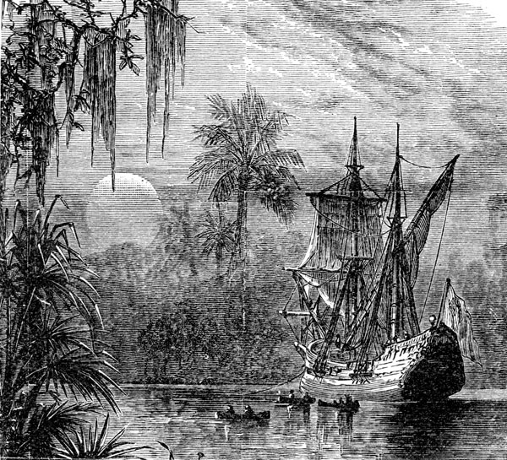
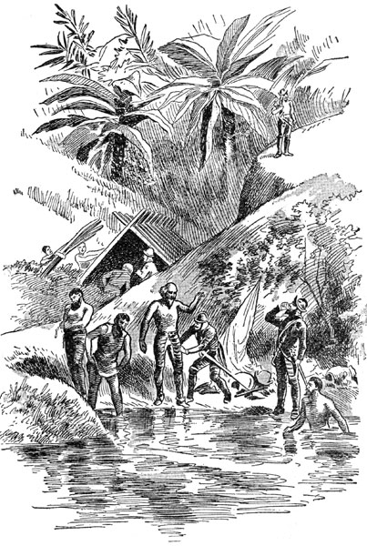
Coming to Florida
Not the First Mainland Explorer
Sponsored by King Ferdinand
March 1513: Left Bahamas to Sail to Florida
April 1513: Arrived in Florida and named it La Florida
1521: Second Trip to Florida
Notes:
What does sponsored mean?
Why did King Ferdinand want to explore Florida more?
If he wanted more land, why? Why did King Ferdinand want to settle La Florida?
This second trip was supposed to settle Florida. However, the Native Americans, who we will learn about next week, did not let that happen.

Slide 6
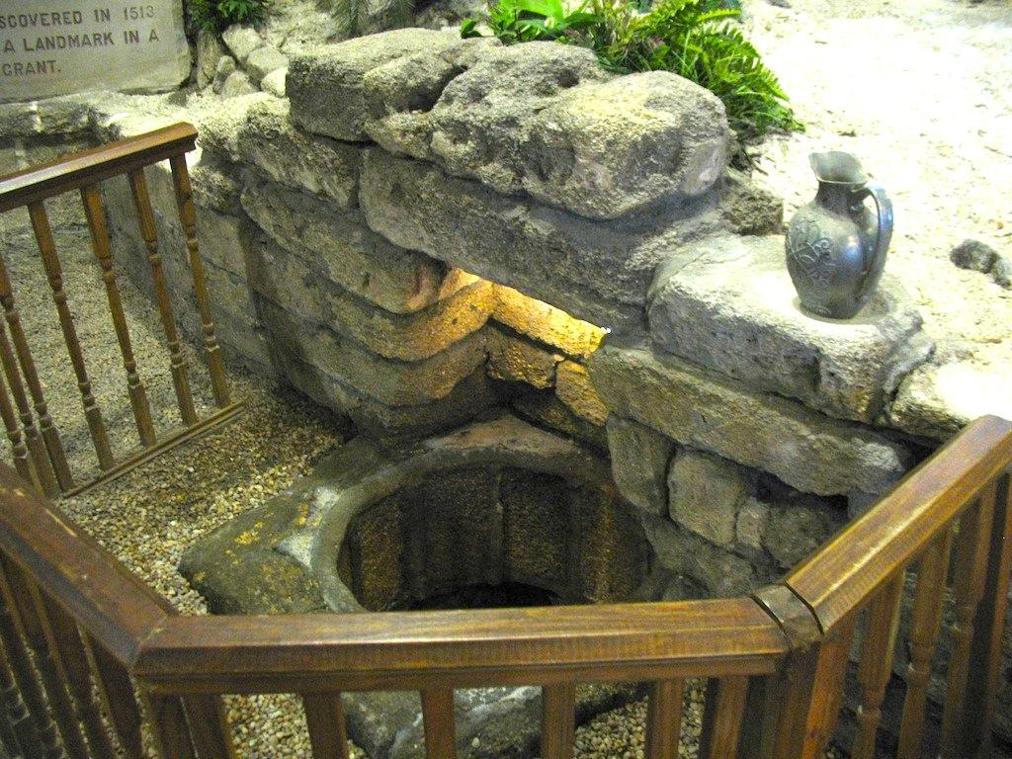
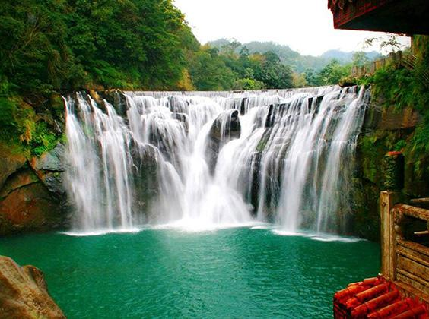
Fountain of Youth
Notes:
“Yesterday, we all drank some water from the fountain of youth. This is what many people believe Juan was trying to find, as per the request of the king. Today, you will see what he was really trying to find.”
What do you think he was trying to find?
answer: gold
Do you think he ever found it?
answer: no
http://myamericanodyssey.com/discovering-a-real-fountain-of-youth-in-st-augustine-fl/
http://hiconsumption.com/2014/06/worlds-most-amazing-waterfall-pictures/

Slide 7
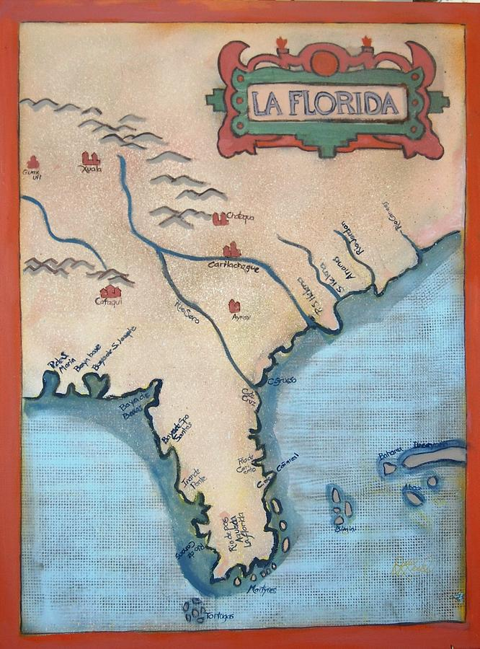
Why is Juan Important?
He named Florida!
First governor of Florida
Helped to complete the map
(Europeans believed Florida was an island off the coast of Asia)
He did not settle Florida, but he helped to start others on the idea.
Notes:
https://fineartamerica.com/featured/la-florida-deborah-reid-.html

Slide 8
Notes:
Transition to Flags
“We talked about how Spain wanted to set up a colony in Florida. This is because they wanted to gain more land and gold so they could be more powerful than the other European countries, or empires.”
One thing people do when they explore a new place is they put up a flag.

Slide 9
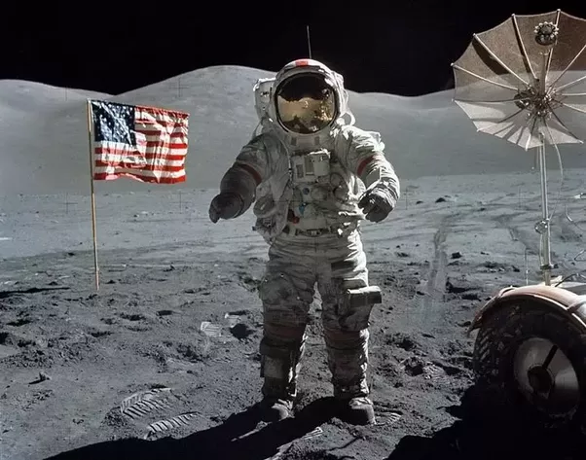
Notes:
Why do people/countries do this?
https://www.quora.com/Since-there-is-no-wind-or-atmosphere-on-the-Moon-how-can-the-US-flag-be-flapping-in-pictures-of-the-first-Moon-landing

Slide 10
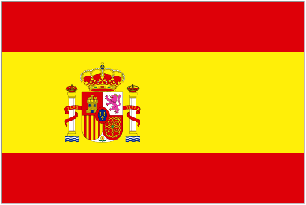
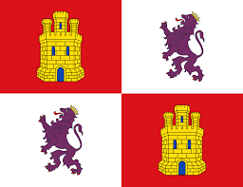
Notes:
This was the Spanish flag for Castile and Leon during the time of Ponce de Leon. This is the flag of Spain now.
https://en.wikipedia.org/wiki/Flag_of_Castile_and_Le%C3%B3n
http://www.flags.net/SPAN.htm

Slide 11
Meaning
Red: Courage
Yellow: Sun, Wealth
Coat of Arms:
The Different Kingdoms
Hercules’ Pillars: Power
Large Crown: Royalty, Regality

Slide 12
Centers

